Slide 1
motivating Slides

Slide 2
Outline
Program status/summary (Matt)
Where we are/accomplishments
The IMMoRTALS Tactical SA Information Sharing Platform (Matt)
Challenge Problems, Motivating examples, concept of operation, illustration of the problem/solution space & complexity
Technical Deep Dive (Matt introduces & then hands off)
Summarize current thrusts that we are working on, identify the 1 or 2 that we will deep dive into
Candidates for deep dive (will we have time for all?)
Modeling the ecosystem– why it is important, what have we done, what next (Vanderbilt)
Discovering resource dependency & requirements– why it is important, what have we done, what next (two parts– Syracuse & OSU/Alex)
DAS in action– demo/screenshots (BBN)
Plans for the next quarter (Matt)
Conclusion (Matt)

Slide 3
PlaceHolder: Vanderbilt
Discuss three aspects of “deployment model”
Physical topology (e.g. which wires are plugged where)
Application topology (e.g. which applications are connected to which other applications
Mission requirement specification (e.g. domain-specific variants of baseline application requirements)
Discuss GME tool for modeling & generating deployment models & supporting deployment scripts

Slide 4
Primary Slides

Slide 5

Environment / Mission Overview
Dynamic inputs (ecosystem model)
Environment
Mission Req
X …
X …
X ...
Static inputs
Resource DSL
Discovery
Analysis
Constructed System
Feature Model
App Model
f₁ * f₂
(g+h)
x
Partial Annotations
Permanent Store
DFU Types
r₁ {...}
r₂ {...}
@dfu
...
@dfu
r₁ {...}
r₂ {...}
@dfu
...
@dfu
r₁ {...}
r₂ {...}
@dfu
...
@dfu
The environment & mission motivate the design of the constructed system
Notes:
New mission requirement:
Secure the data-at-rest
Scale up number of users from 10^1 to 10^3
Identify a mapping between mission goals & technology & procedure.
Increase the number of mobile devices.

Slide 6

Modeling the Ecosystem
What is the ecosystem?
Why is the ecosystem important?
What have we done to model the ecosystem?
What next?
Adaptation demands originate from the ecosystem
Notes:
Modelling the ecosystem
What is the ecosystem?
Why is the ecosystem important?
What have we done to model the ecosystem?
What next?

Slide 7
Modeling the Ecosystem
What is the ecosystem?
Why is the ecosystem important?
What have we done to model the ecosystem?
What next?
Dynamic inputs (ecosystem model)
Environment
Mission Req
X …
X …
X ...
The ecosystem is everything that impinges upon the constructed system
Notes:
Modelling the ecosystem
What is the ecosystem?
The ecosystem consists of the environment & the mission goals & objectives.

Slide 8
Modeling the Ecosystem
What is the ecosystem?
Why is the ecosystem important?
What have we done to model the ecosystem?
What next?
Dynamic inputs (ecosystem model)
Environment
Mission Req
X …
X …
X ...
Static inputs
Resource DSL
Discovery
Analysis
Feature Model
App Model
f₁ * f₂
(g+h)
x
Constructed System
Partial Annotations
Permanent Store
DFU Types
r₁ {...}
r₂ {...}
@dfu
...
@dfu
r₁ {...}
r₂ {...}
@dfu
...
@dfu
r₁ {...}
r₂ {...}
@dfu
...
@dfu
The ecosystem & application model prescribe & specify the constructed system
Notes:
Modelling the ecosystem
Why is the ecosystem important?
The ecosystem is symmetric to the constructed system.
The ecosystem issues a set of challenges to which the constructed system responds.
We generate a set of specifications from the ecosystem models.

Slide 9
Modeling the Ecosystem
What is the ecosystem?
Why is the ecosystem important?
What have we done to model the ecosystem?
What next?
Mission Model
Execution Environment Model
Component Model
Network Connectivity Model
Topic Model
The models interact
Notes:
Modelling the ecosystem
What have we done to model the ecosystem?
The models interact producing complex and emergent behavior.

Slide 10
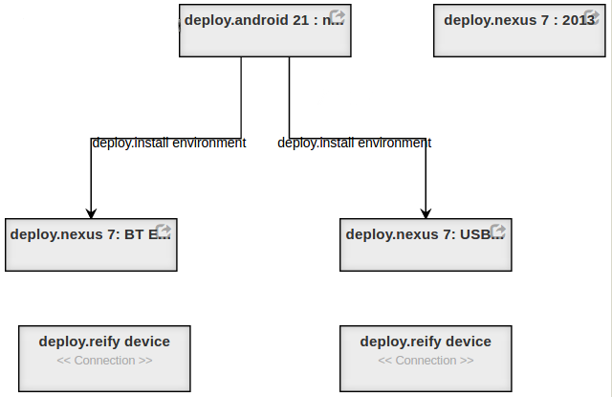
Modeling the Ecosystem
What is the ecosystem?
Why is the ecosystem important?
What have we done to model the ecosystem?
What next?
Execution Environment model
How are packages combined to form execution environments suitable for deployment to devices
The components are combined to form packages for specific purposes.
Notes:
Modelling the ecosystem
What have we done to model the ecosystem?
The Execution Environment Model assembles a set of component DFU’s into a deployable package.

Slide 11
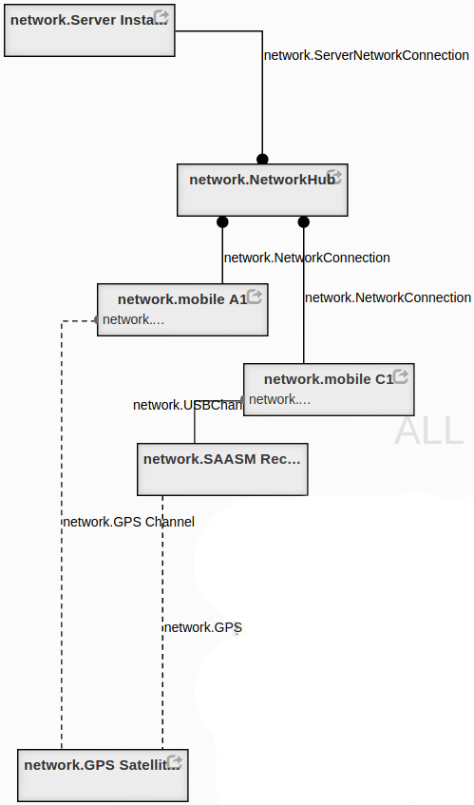
Modeling the Ecosystem
What is the ecosystem?
Why is the ecosystem important?
What have we done to model the ecosystem?
What next?
Network topology model
Along what paths are devices able to communicate?
The network topology model names hardware & their locations
Notes:
Modelling the ecosystem
What have we done to model the ecosystem?
The Network Topology Model describes the intended configuration of specific network devices.

Slide 12
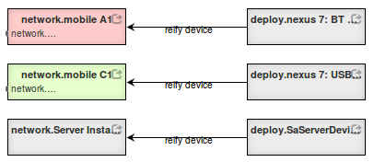
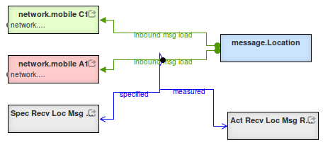
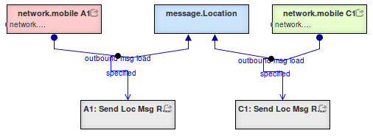
Modeling the Ecosystem
What is the ecosystem?
Why is the ecosystem important?
What have we done to model the ecosystem?
What next?
Mission model
Where do messages originate?
To whom are they directed?
Build a mega-model including cross-cuts
Notes:
Modelling the ecosystem
What have we done to model the ecosystem?
The Mission Model describes the goals for the application in a particular context.

Slide 13
Modeling the Ecosystem
What is the ecosystem?
Why is the ecosystem important?
What have we done to model the ecosystem?
What next?
Generate script to deploy software to specific devices
Formal methods
Type systems (DSL)
Construction following specification
Property-based testing & survey
Run time observation & measurement
Construct logger configuration to record & monitor key metrics
The ecosystem mega-model specifies behavior for the constructed system
Notes:
What next?
We generate a set of specifications from the ecosystem models.
These specifications can be used to verify the constructed system:
By formal methods (other players)
By type-systems (OSU)
By construction according to the model (in-progress )
By property-based testing in simulated environments (Syracuse)
By observation & measurement of fielded system (LL)
Property-based:
https://fsharpforfunandprofit.com/posts/property-based-testing-2/
https://www.youtube.com/watch?v=zi0rHwfiX1Q

Slide 14
Optional Slides

Slide 15
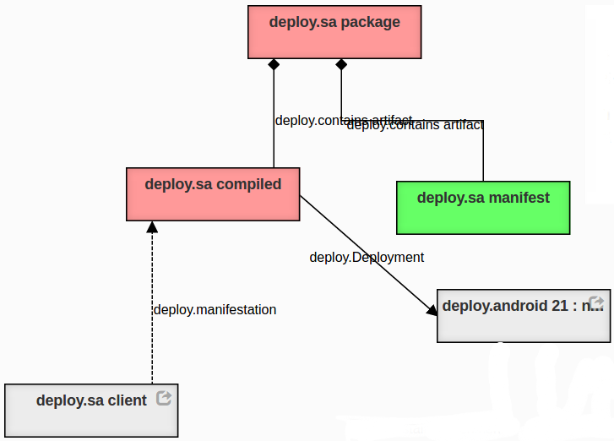
Modeling the Ecosystem
What is the ecosystem?
Why is the ecosystem important?
What have we done to model the ecosystem?
What next?
Component construction model
How are DFU’s composited to form components?
The components are assembled
Notes:
Modelling the ecosystem
What have we done to model the ecosystem?
The Component Assembly Model assembles a set of component DFU’s into a deployable package.

Slide 16
Modeling the Ecosystem
What is the ecosystem?
Why is the ecosystem important?
What have we done to model the ecosystem?
What next?
Graph Based Macro Templates for Implementation
Compose software elements by binding templates.
Archive templates as tree fragments.
Visualizations
Type-system examination and editing.
Impact analysis examination.
Initiate mediation activities.
Graph based visualization
Other perceptive models
Specification Based Verification
Use formally validated components when available.
Type-based checking.
Property based testing in simulated environments.
Analysis of Models by Graph Traversal
Source code contain more information than needed for analysis —models strip away the incidental complexity— .
Source code lacks information for many types of analysis —integrating specification through annotations can help—
Conveniently retain inter-model relationships —Identify conflicts by examining cross cuts—.
Stream Based Data Storage Models
Run time
Model edits
Data store queries
Performance studies
The ecosystem mega-model specifies behavior for the constructed system
Notes:
Some other candidates for future effort.
The braided blivet is an icon that expresses the fundamental problem.
Who is responsible for solving a conflict in the system?
The round tines or the square tines, internally they are both consistent.
They both conform to the interface.

Slide 17
Model Visualization with GME
Notes:
The GME tool for modeling & generation of validation & construction artifacts.

